Slide 1
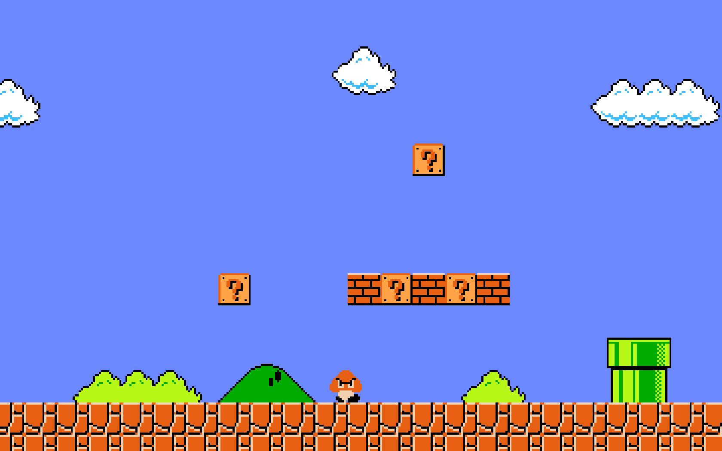
AFTER GAME OVER
> PLAYER1 : 20211599 HYUNSOO JOO

Slide 2
CONCEPT:
MARIO’S LIFE AFTER WORKS
( AFTER GAMEOVER)
From the perspective of the game character,
I thought "GAMEOVER" was the way to get off work.
Through this concept, I decided to express Super Mario's after work.

Slide 3
THEME:
Comfort for the fatigue and impatience that arise from the repetitive daily routine.
Even Super Mario, who seems to play every day, showed that he feels tired in his daily life. I just wanted to say, we're all in this hustle together, and I'm here to give you a little comfort.
“Let’s all get through it together, even though we are busy”

Slide 4
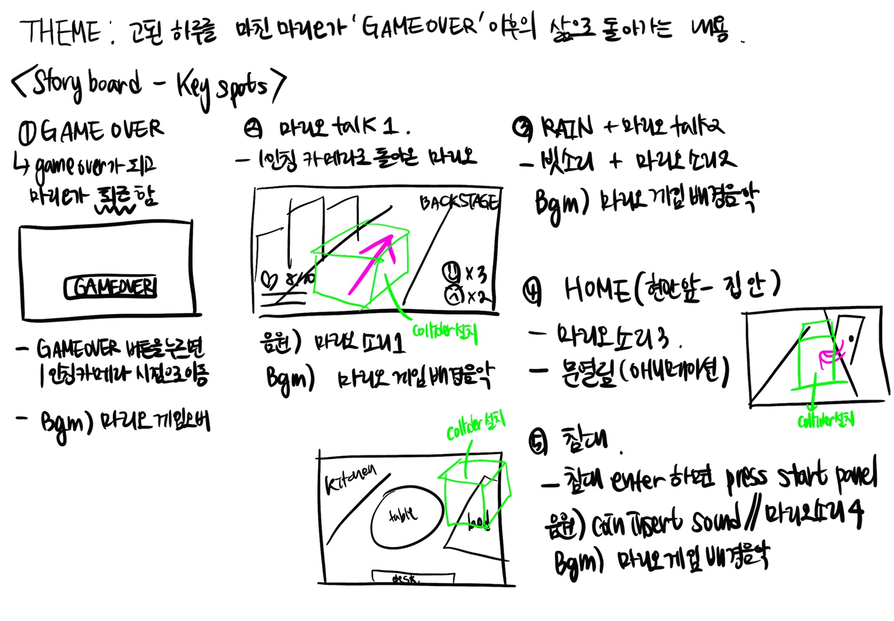
STORY BOARD:

Slide 5
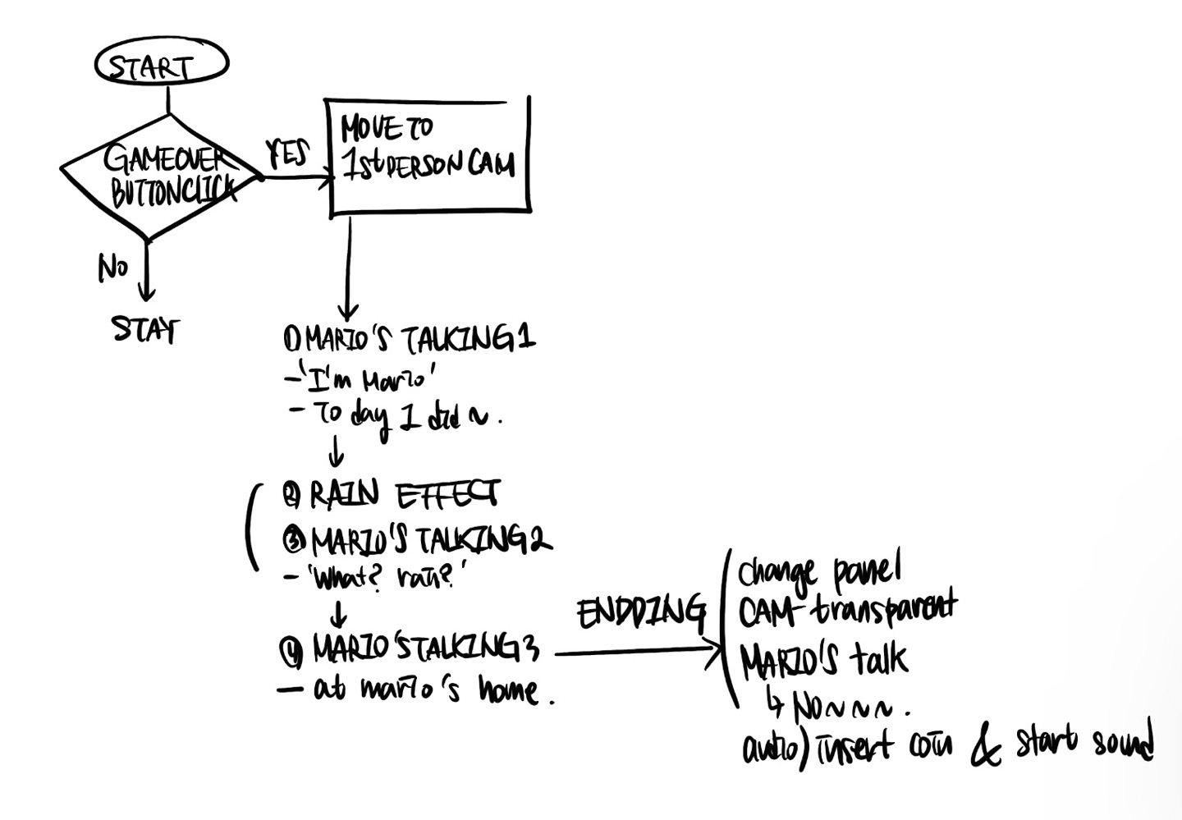
FLOW CHART:

Slide 6
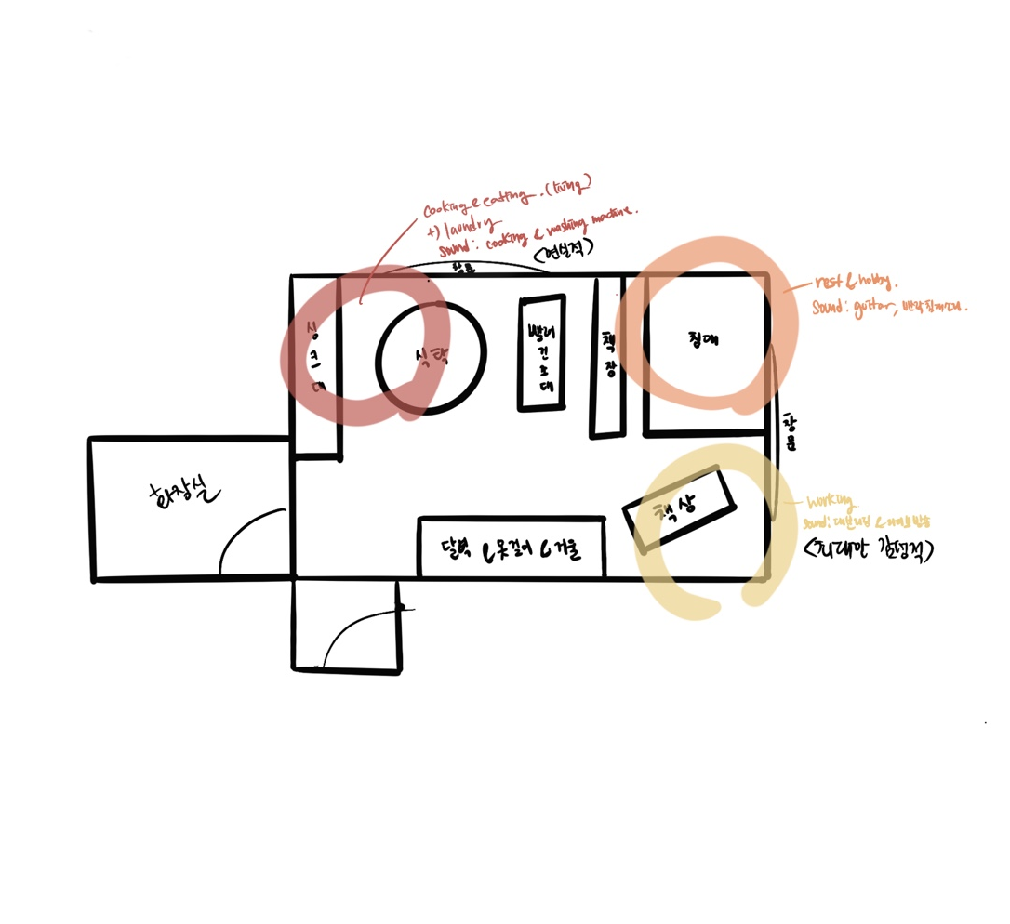
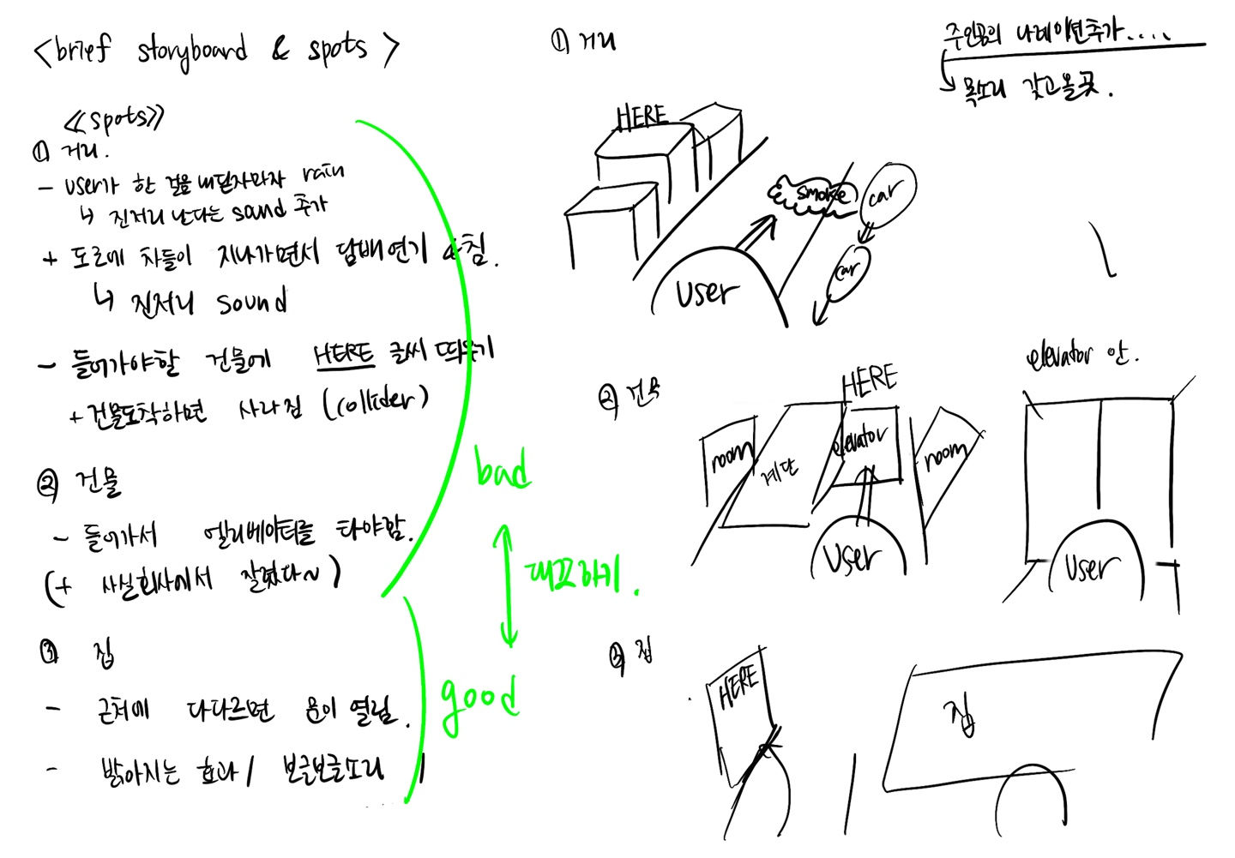
SKETCH 1ST TRY:

Slide 7
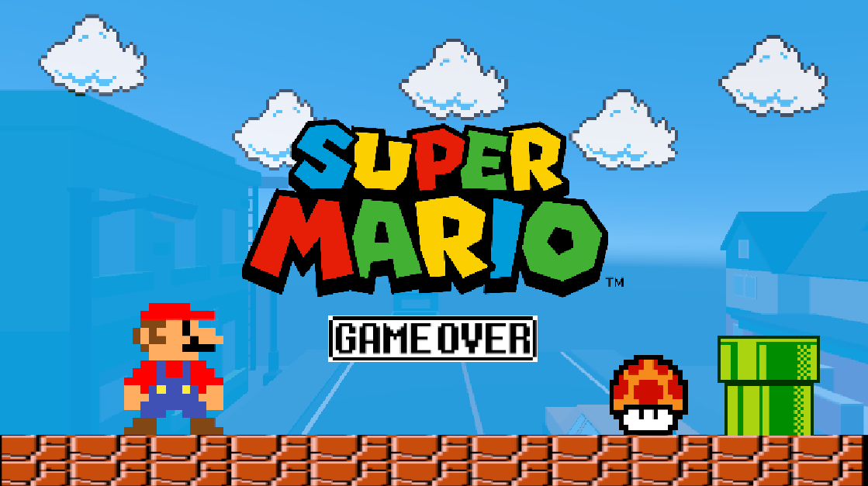
1. GAMEOVER SCENE:
MENU PANEL
- can see the camera's view behind the translucent screen
- when user click the ‘GAMEOVER’ button, it goes to 1st person camera view

Slide 8
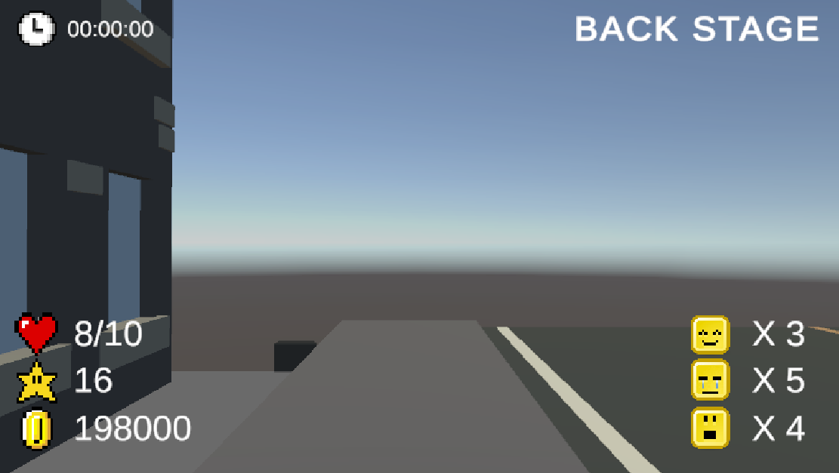
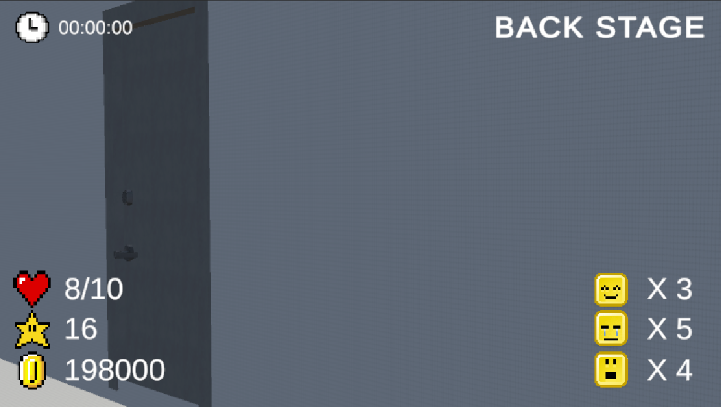
2. ROAD SCENE:

Slide 9
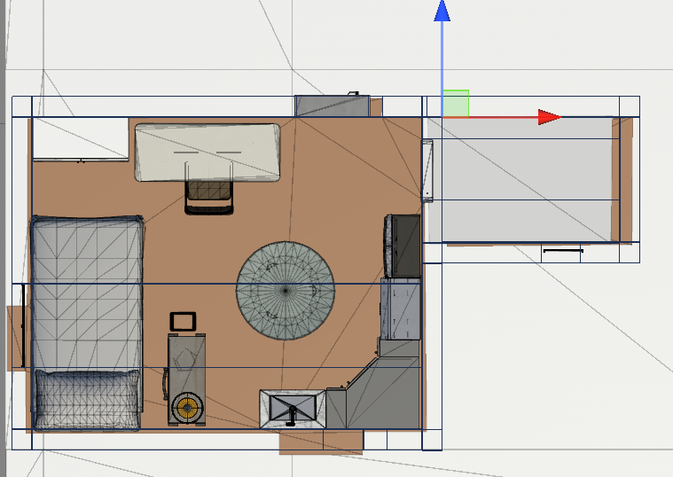
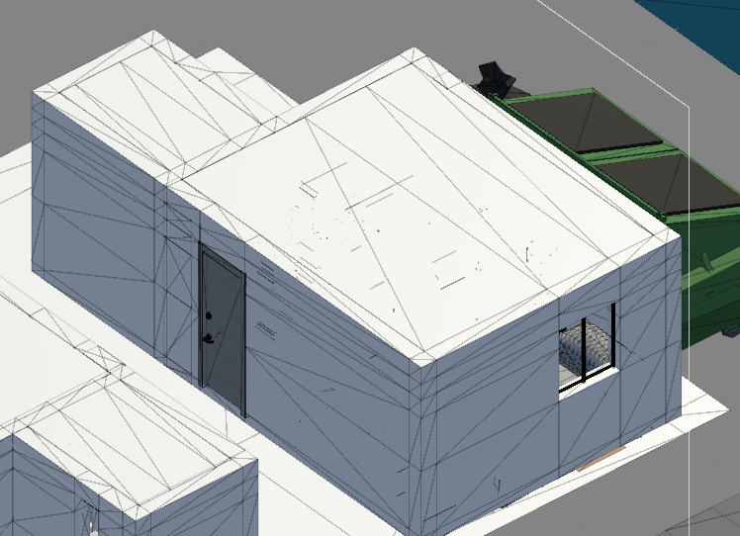
3. MARIO’S HOME:
-By using my sketch, I build mario’s home with probuilder.

Slide 10
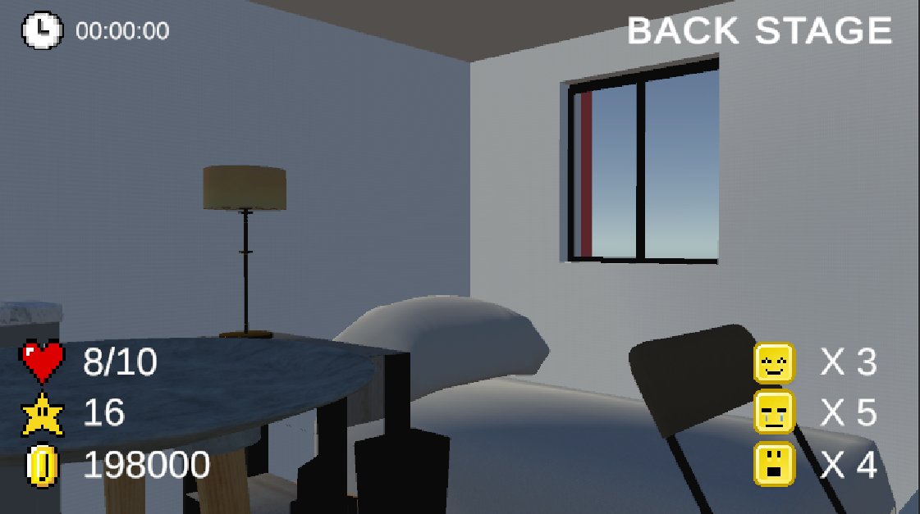
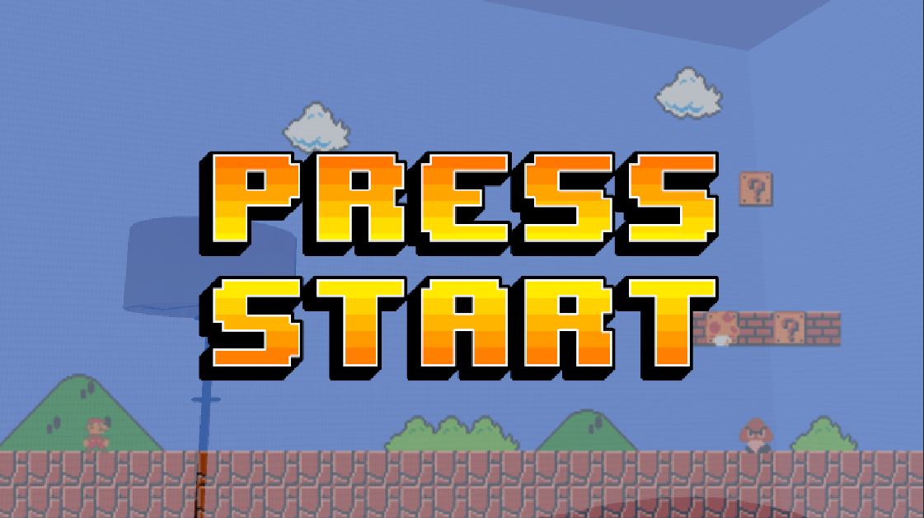
3. MARIO’S HOME:
- As Mario goes to the side of the bed and tries to rest, there is a coin insert sound and Mario's despair that he has to go out again to play the game.

Slide 11
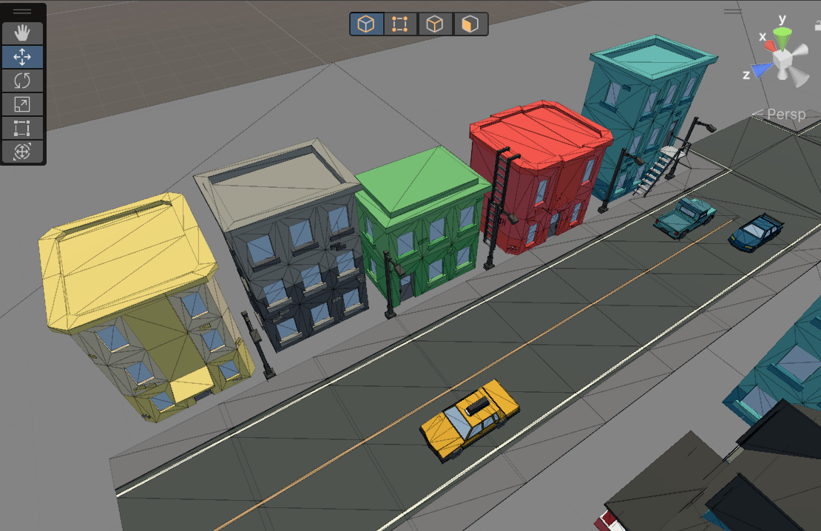
4. MARIO TOWN:

Slide 12
3. reference:
Png download
https://www.pngwing.com/
Unity assets
https://assetstore.unity.com/packages/3d/environments/simplepoly-city-low-poly-assets-58899
https://assetstore.unity.com/packages/3d/environments/apartment-kit-124055
Sound
https://www.youtube.com/watch?v=Aax1SEZESts
https://www.youtube.com/watch?v=KCiVG6mTor0&t=117s
Mario’s voice
https://genny.lovo.ai/

